Slide 1
Corona in India
Ravirajsinh Dabhi
IBM Applied Data science capstone

Slide 2
In this presentation you will find out some case study related to corona virus spread in all over India.
You will find out about detail with visualization.
I am using data available in Wikipedia page of all state of the India. https://en.wikipedia.org/wiki/2020_coronavirus_pandemic_in_India

Slide 3
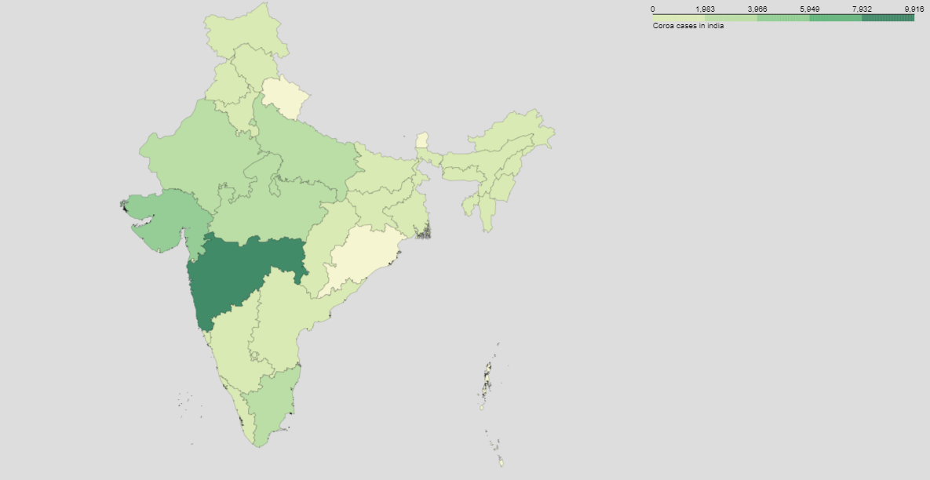
Choropleth map of cases in each state

Slide 4
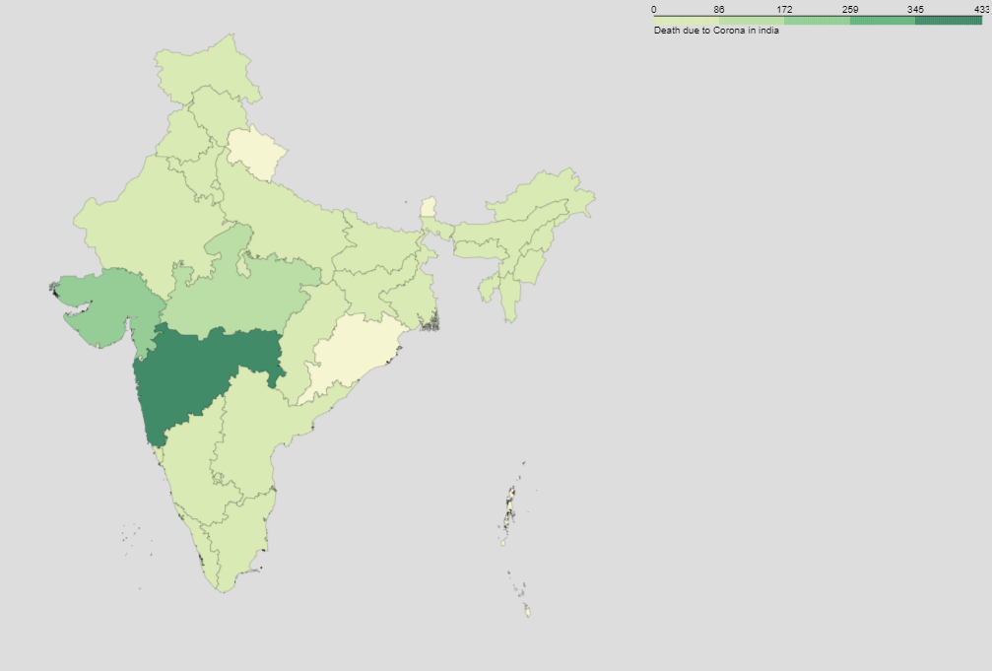
Choropleth map of deaths due to corona in each state

Slide 5
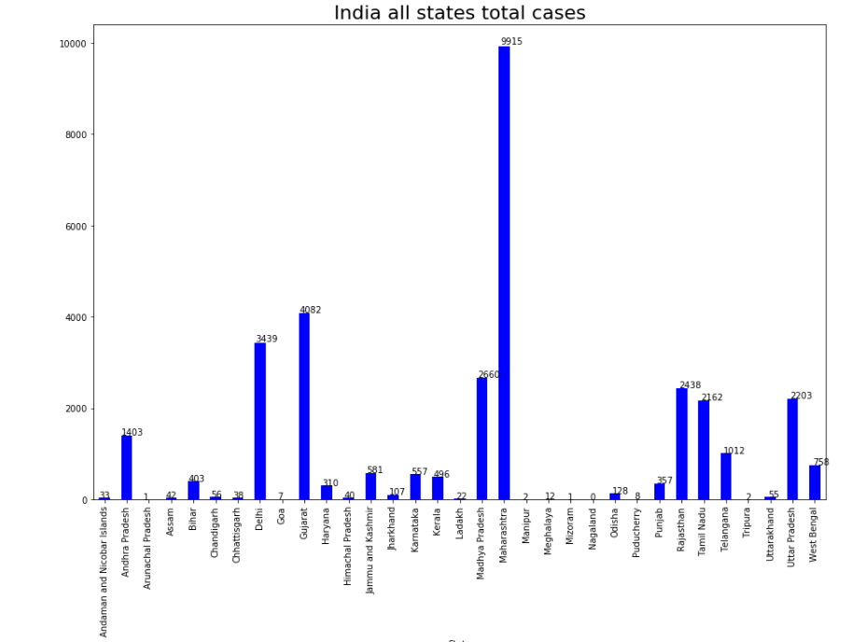
This is cases till 30th April, 2020
Highest cases is in Maharashtra with 9915 cases
Second highest is Gujarat with 4082 cases.
Nagaland is not recorded single cases.
Goa, Arunachal Pradesh, Mizoram, Tripura have better condition.

Slide 6
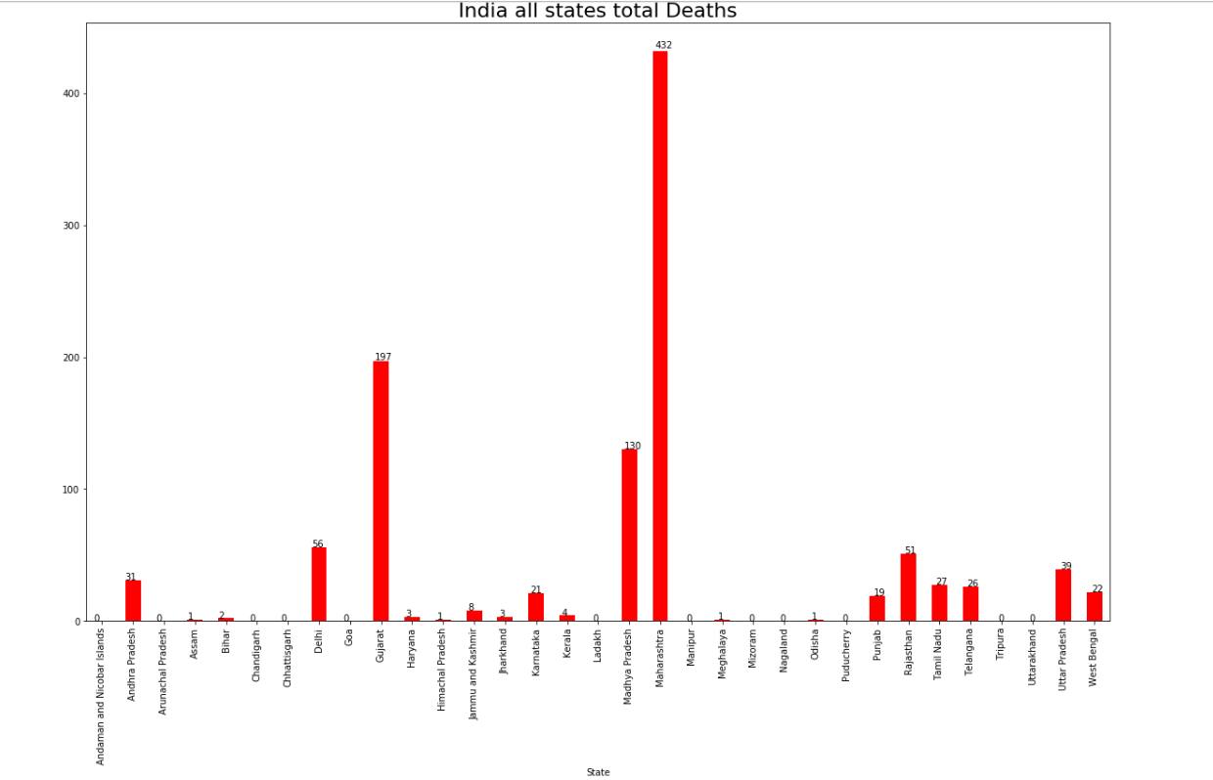
Cases and deaths is directly proportional to each other.
Like wise Maharashtra have highest number of deaths numbers. It records total432 deaths.
Gujarat is second with 197 and Madhya Pradesh is third with 130.

Slide 7
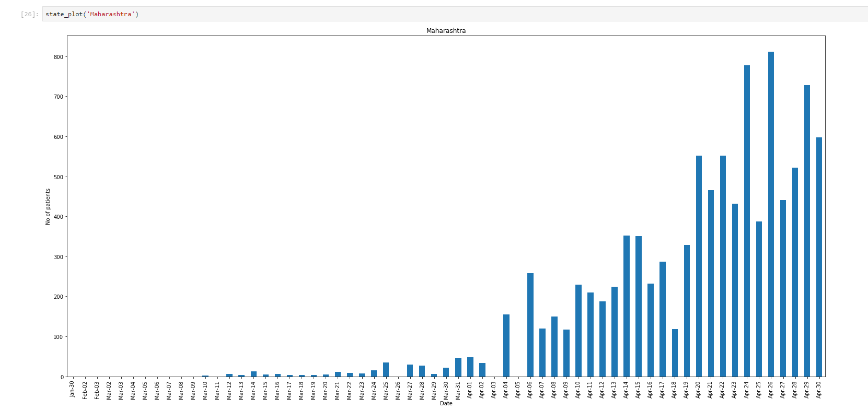
Corona cases in maharashtra on each day
First case is record on 10th march, 2020.
Highest case record on 26th April, 2020.

Slide 8
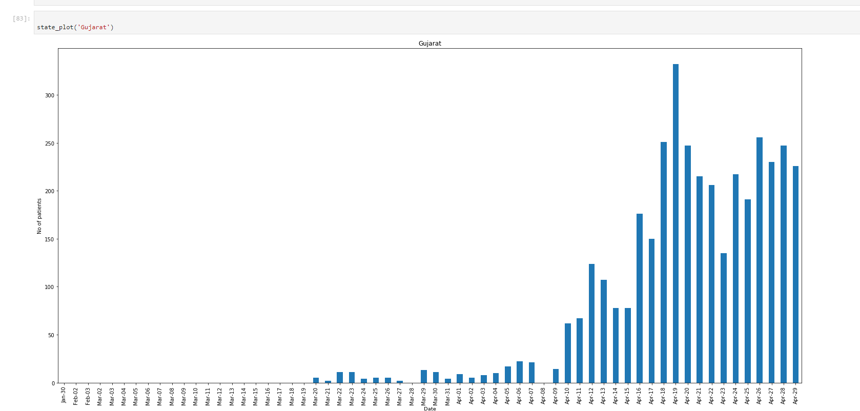
Corona cases in Gujarat on each day
First case is record on 20th march, 2020.
Highest case record on 19th April, 2020.

Slide 9
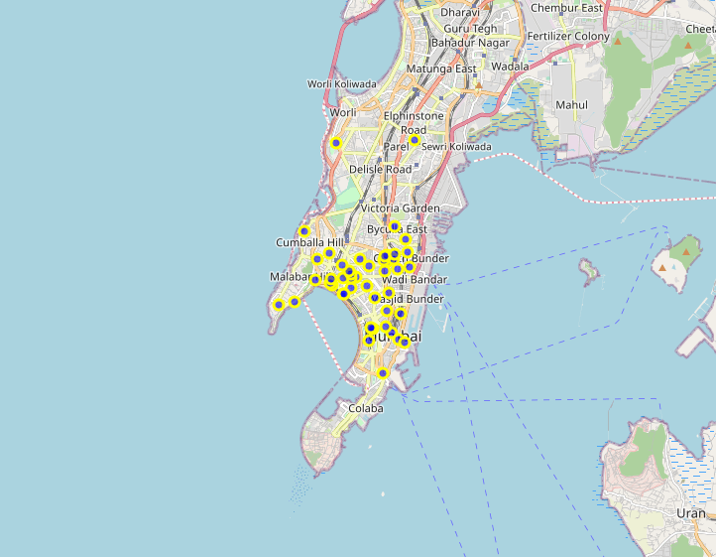
Location of top hospital in mumbai
Maharashtra have highest number of cases in India.
Mumbai city have highest number of cases of corona virus.
So I try to find some good hospital location in Mumbai city
I used foursquare API to locate hospital in Mumbai.

